Slide 1
AMReX - a new framework for block-structured adaptive mesh refinement calculations
Andy Nonaka
Lawrence Berkeley National Laboratory
SciDAC-TEAMS Collaboration Meeting: August 22, 2018

Slide 2
What is AMReX?
AMReX is a block-structured Adaptive Mesh Refinement (AMR) framework for solving systems of nonlinear PDEs for a variety of US Department of Energy applications.
DOE Exascale Computing Project (ECP) Co-Design Center
Mission of the Co-Design Center
Support applications
Evaluate new software technologies
Interact with vendors
Much of the algorithmic methodology is developed as part of the DOE Applied Math Program

Slide 3
Cast
Ann Almgren
John Bell
Weiqun Zhang
Marcus Day
Andy Nonaka
Brian Friesen
Kevin Gott
Andrew Myers
Steven Reeves
Tan Nguyen
Cy Chan
Sam Williams
Anshu Dubey (ANL)
Petros Tzeferacos (U Chicago)
Klaus Weide (U Chicago)
Ray Grout (NREL)
Shashank Yellapantula (NREL)

Slide 4
More About AMReX
Supports the development of block-structured AMR applications for current and next-generation architectures
Doesn’t dictate anything about the physics, the discretization, or the numerics other than fundamentally uses block-structured mesh
Provides support for
Explicit & implicit mesh operations
Multilevel synchronization operations
Particle and particle/mesh algorithms
Solution of parabolic and elliptic systems using geometric multigrid solvers
Embedded boundary (cut-cell) representation of geometry

Slide 5
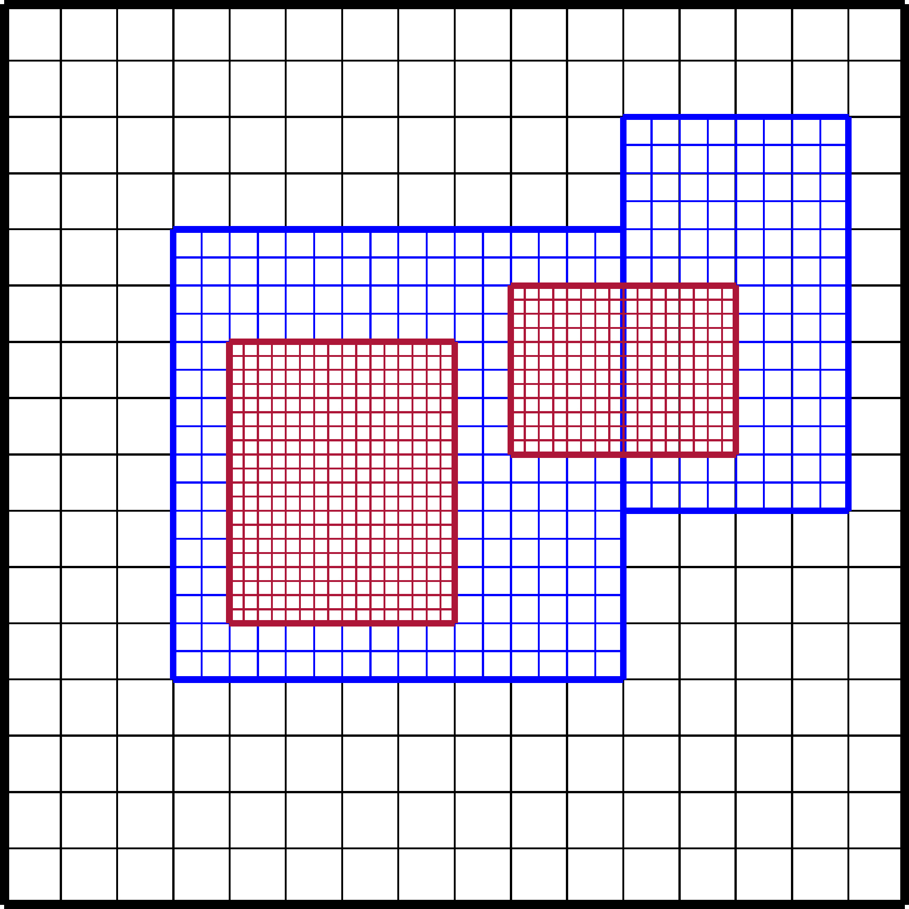
What is Block-Structured AMR?
In block-structured AMR, the solution is defined on a hierarchy of levels of resolution, each of which is composed of a union of logically rectangular grids/patches
Patches can change dynamically
Oct-tree refinement with fixed size grids is special case
More generally, patches need not be fixed size and do not have a unique parent-child relationship

Slide 6
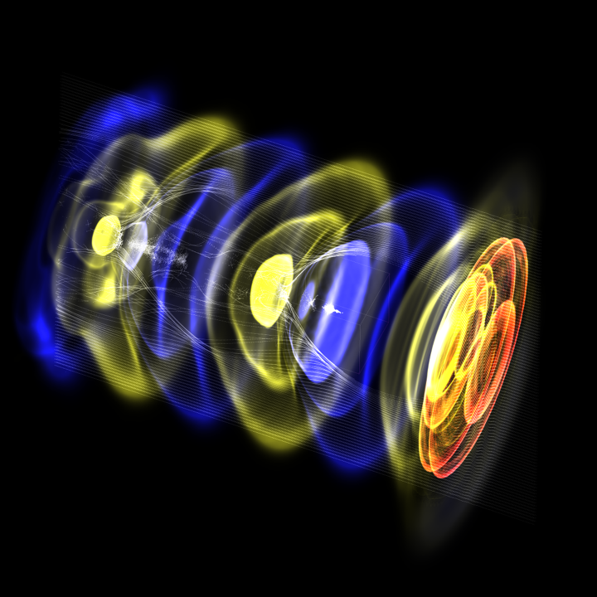
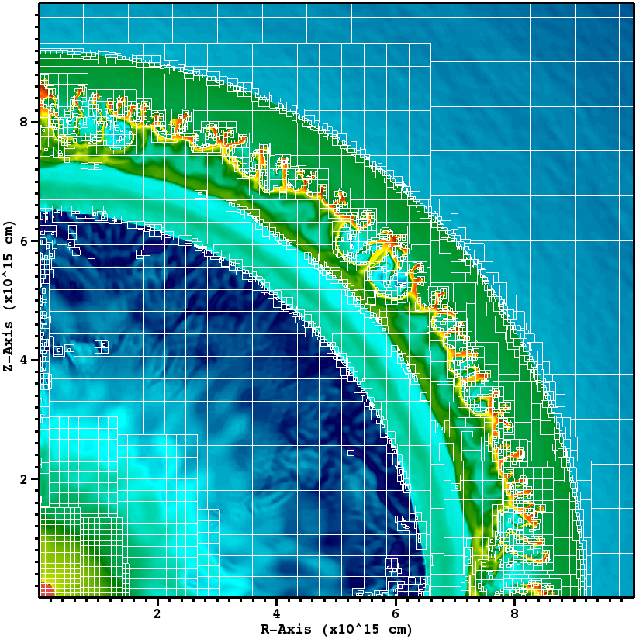
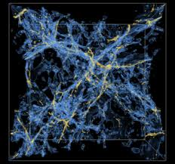
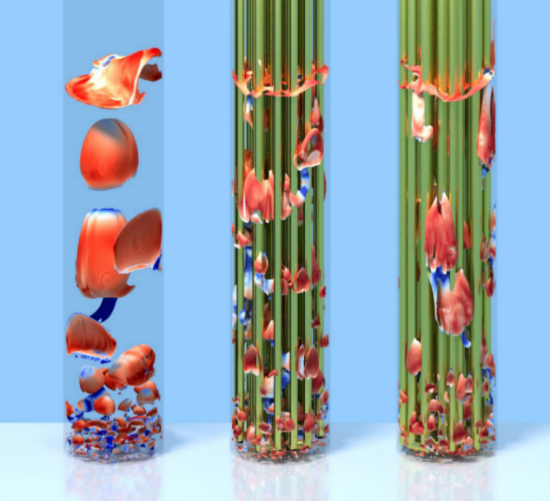
AMReX Widely Used in DOE Applications
Five ECP application projects that partner with AMReX:
Accelerators
Astrophysics
Cosmology
Multiphase flow
Other applications
Clouds / Atmospheric dynamics
Fluctuating hydrodynamics (stochastic PDEs)
Fluid-structure interaction
Solid mechanics
Low Mach Number Astrophysics (MAESTRO)
Combustion

Slide 7
Additional Features
Implemented in C++11 / Fortran90
Open development model
Publicly available on Github; anybody can see the latest changes
Issues, pull requests encouraged (bug fixes, new features, documentation, etc...)
All branches public. Bleeding edge development branch, merged into master monthly.
Most ECP application codes and many other applications also publicly available.
Extensive documentation
Sphinx, doxygen documentation hosted on Github pages, auto-generated with Travis.
Large number of tutorial codes to help you get started.
Github issues for user questions – prompt responses.

Slide 8
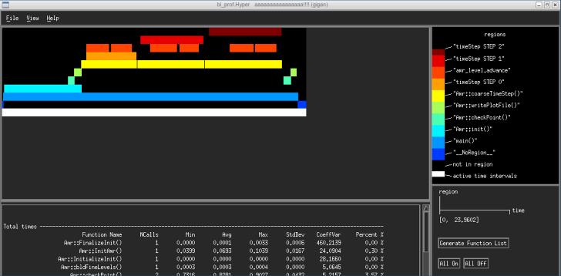
Additional Features
Built in performance measurement tools
Simple summary characterization and/or highly detailed measurements
Measure both computation and communication
Ability to localize detailed measurements

Slide 9
Additional Features
Interfacing with other Libraries
SUNDIALS ODE solvers
Hypre, HPGMG solvers
FFTW and other FFT libraries
In-situ and in-transit analytics - Sensei, ALPINE, Henson
Visualization and I/O
In-house data format with efficient parallel I/O for both restart and plotfiles (has been much faster than HDF5 … although that is changing)
Visualization format supported by VisIt, Paraview, yt

Slide 10
Basic Data Structures
Invect
Mesh point at a given level
Box
Rectangular collection of mesh points at a level
FArrayBox
Data defined on a box (double, integer, etc.)
Stored in column-major order (Fortran)
Optional contains space for boundary (ghost) data
BoxArray
List of boxes at a level
MultiFAB
List of FArrayBoxes associated with a BoxArray

Slide 11
Core Parallelization Strategy
DistributionMapping maintains an mapping between Boxes in a BoxArray and MPI rank
Several data distribution strategies such as knapsack and space-filling curve
Load-balancing based on work estimates
Parallel operations defined on MultiFabs
MultiFabs can be operated on using add, divide, saxpy, etc..
Also provide MFIter for looping over the FArrayBoxes in a MultiFab.
Owner computes rule
Each proc loops only over the data it owns, details are hidden in application code

Slide 12
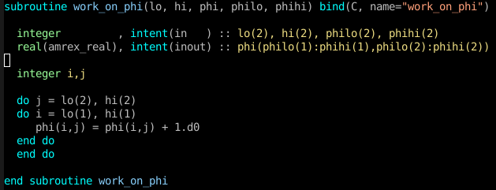

Slide 13
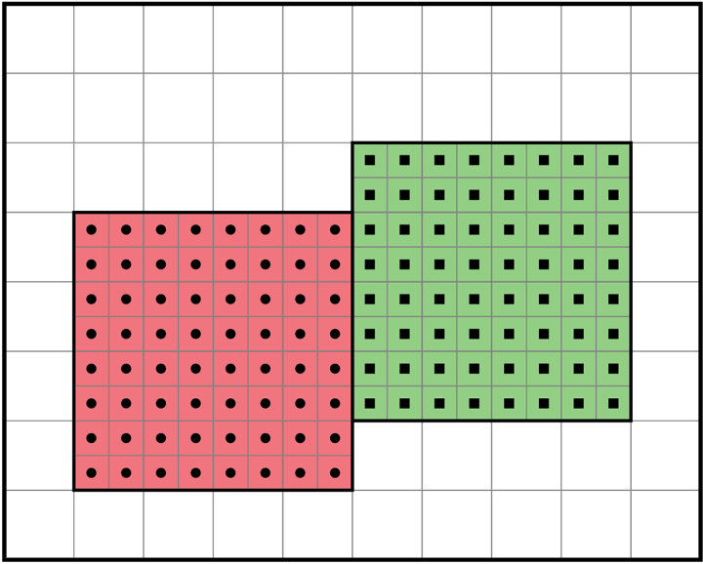
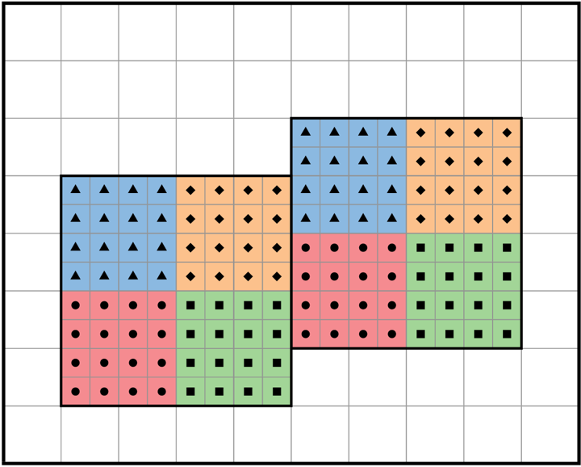
Core Parallelization Strategy
Supports a variety of programming models - MPI, OpenMP, Hybrid, and (increasingly) GPUs (more on this later)
OpenMP implemented via fortran loop directives or logical tiling
Tililng improves cache performance, even if using pure MPI

Slide 14
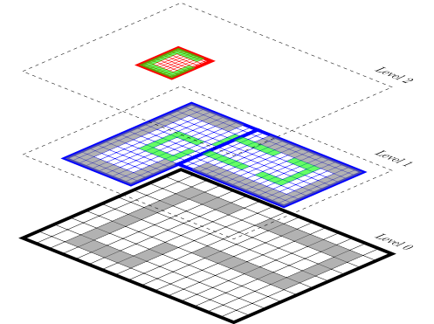
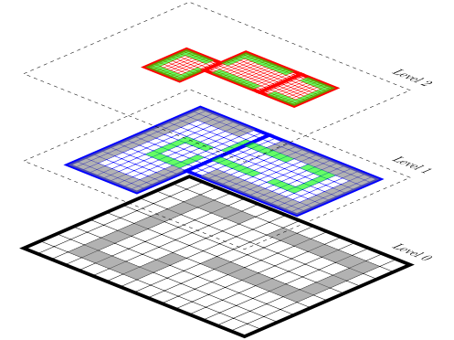
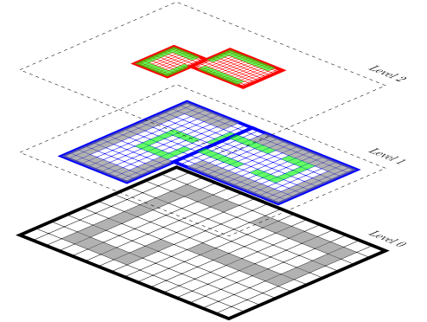
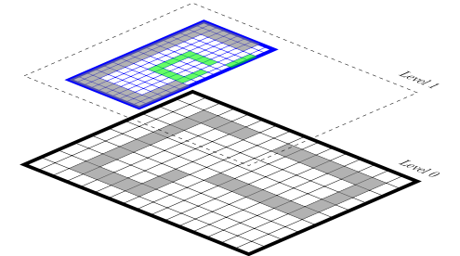
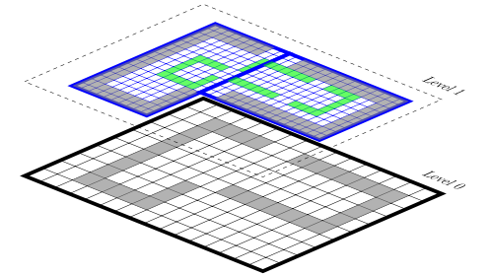
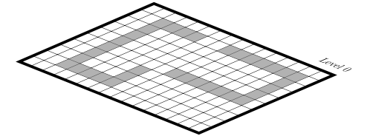
Multi-Level Tools
All data structures are level aware
Well-defined mapping between levels
Interpolation / Restriction
Filling boundary conditions on fine levels from coarse level data
Representing fine solution on the coarse level
Flux Registers
Used to store data on coarse / fine interfaces
Used to enforce conservation for
e.g. hyperbolic systems
Tagging / Regridding
Accumulate sets of points
Generating BoxArrays that cover those points

Slide 15
Linear Solvers
AMReX provides native geometric Multigrid solvers for parabolic and elliptic systems
Currently also building a Stokes solver
Cell-centered and nodal solvers
Single-level and multi-level “composite” solvers
Box agglomeration to avoid coarsening limitations
Consolidation strategy to reduce ranks at coarser level
Current work - extension to EB
Makes the bottom solve much more complex
Exploring transition to algebraic multigrid

Slide 16
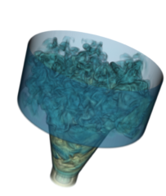
Embedded Boundaries – Walls in Outer Space?
Use a cut cell approach to complex geometries.
Still block-structured, but cells labelled covered, cut, or regular
Within an MFIter loop, ask whether the tile contains any cut cells.
If not, treat in normally.
If it does, pass in extra geometric, connectivity information.
All data structures fully inter-operable with Fortran
Doesn’t sacrifice essential regularity far from domain boundaries.
Much more work to do near boundaries, benefits from dynamic OpenMP scheduling
Prototype injector for gas turbine
Shock reflection test

Slide 17
Particles in AMReX
Another core data type is the particle. In AMReX, particles live on and interact with an adaptive hierarchy of meshes.
Additional challenges:
Inherently irregular - amount of data varies
Connectivity is hard, e.g. finding neighbors.
Always changing, data structures adapt every time step or more
Several different kinds of applications:
Passive tracers
Particle-particle, particle-wall collisions
Particle-in-cell (electro-magnetic, dark matter, drag)

Slide 18
Nyx Code Cosmology – Dark Matter Particles

Slide 19
Particle-Wall Collisions (for Astrophysics?)

Slide 20
New Programming Models and Architectures
Programming models
Fork-join model for coarse-grained asynchronous execution
Interface using C++11 lambda’s
Asynchronous iterators for fine-grained asynchronous execution
Tasked graph derived from AMR metadata
Runtime scheduling support
Investigating use of PGAS communication layer
Much current work focuses on porting AMReX to GPUs
Cuda’s Unified Memory for data motion
Kernels offloaded through a variety of strategies
CUDA C/Fortran
OpenACC
OpenMP
NVIDIA’s thrust library for sorting and searching (particles)
Mini-App versions of Castro hydro (StarLord) and WarpX (Electromagnetic PIC) exist

Slide 21
3 Ways That Applications Use AMReX
Core (library)
Application owns main
Support for single-level structured grid methods and particles
AMReX provides data containers and iterators for distributed data, as well as ghost cell exchange and communication
“User never types MPI…”
AMRCore (library)
Application owns main
Support for block-structured AMR
Inter-level operations – Interpolation, restriction, refluxing (level synchronization)
AMR time step controlled by application
Application must understand how to specify multilevel algorithm
AMRLevel (framework)
AMReX owns main
AMReX controls time step (particularly useful to support subcycling)
Stubs provided for time advance at single level as well as synchronization operations

Slide 22
END

