Slide 1
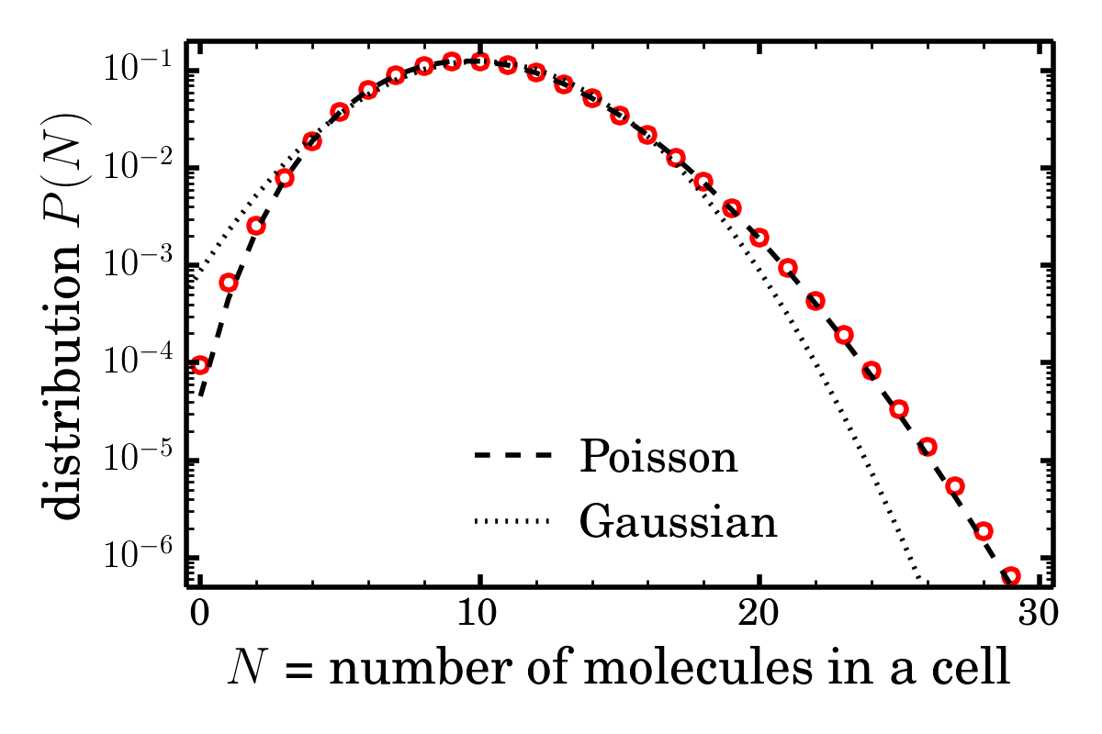
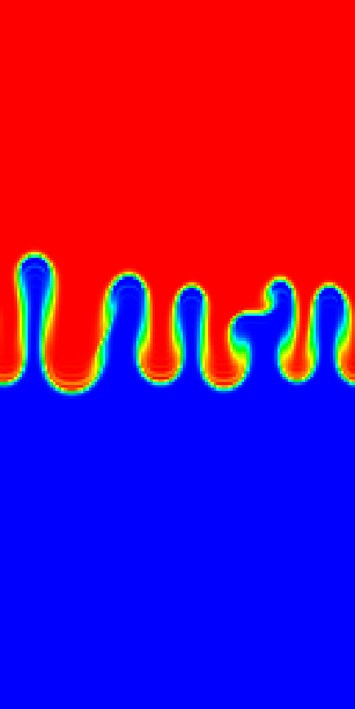
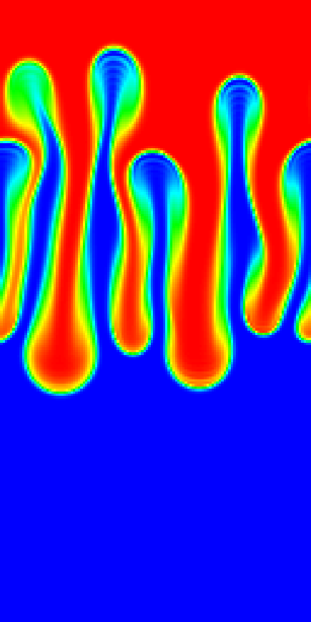
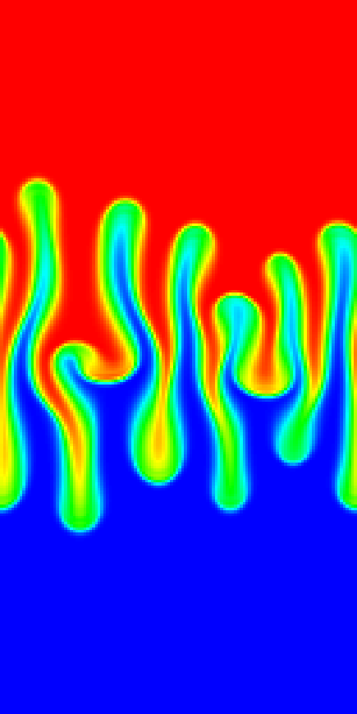
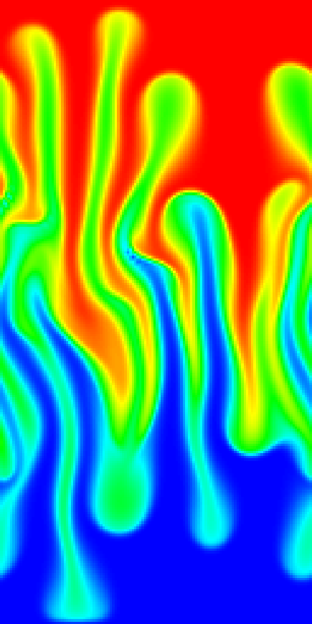
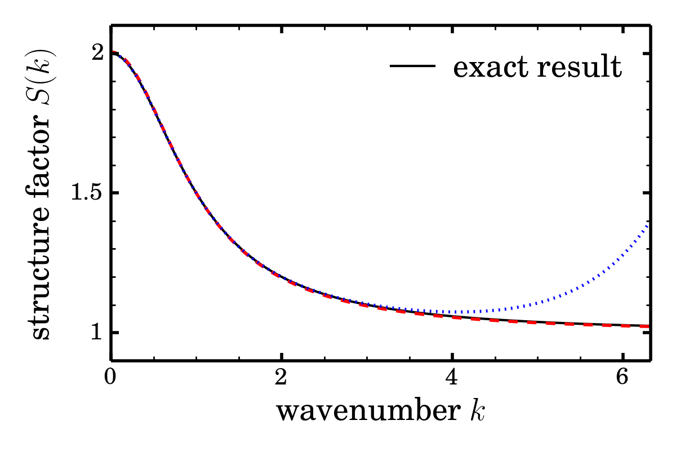
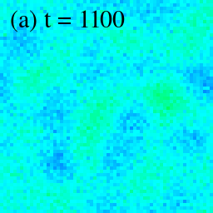
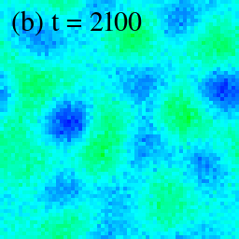
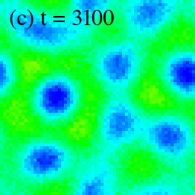
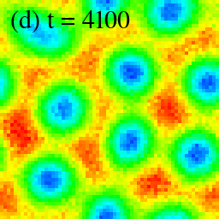
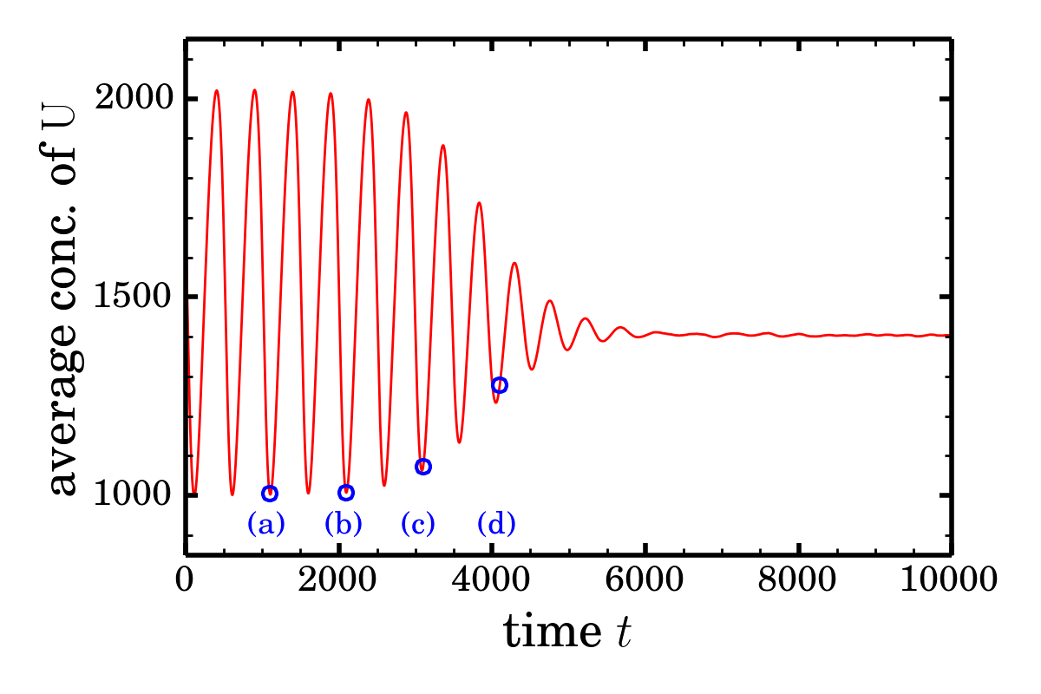
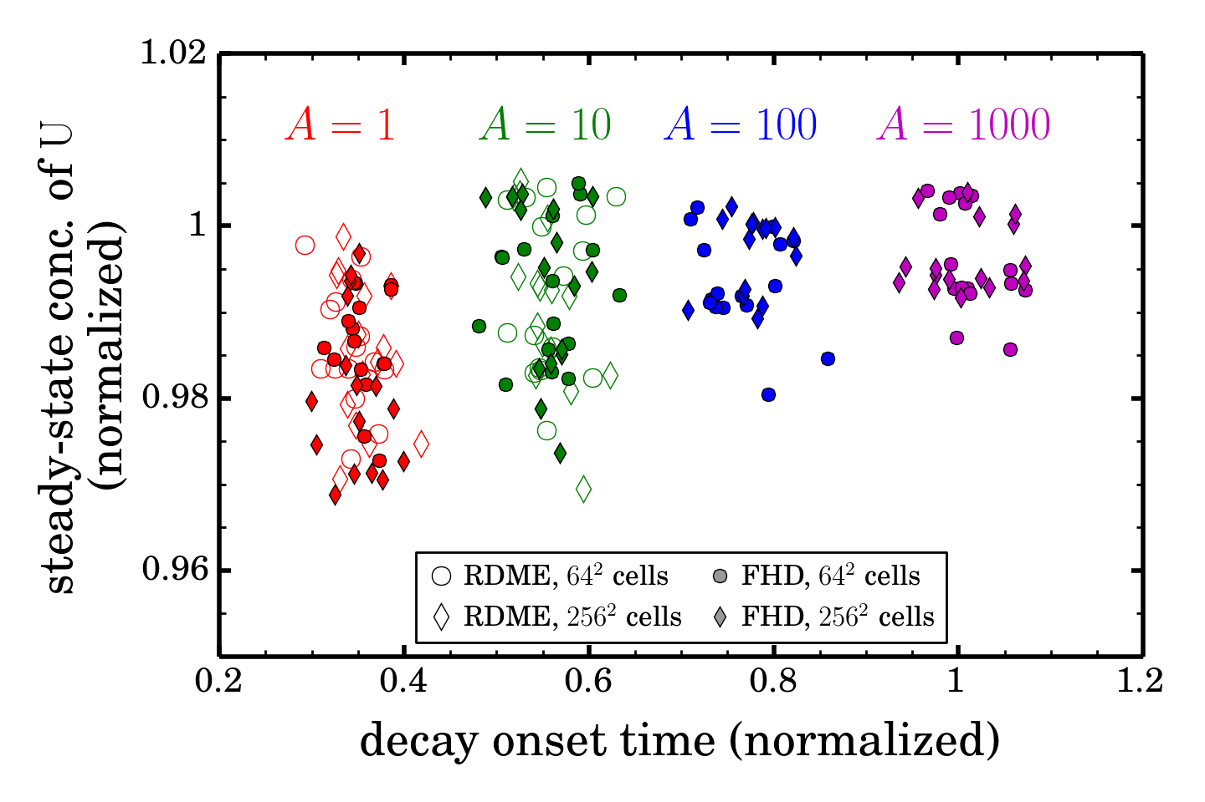
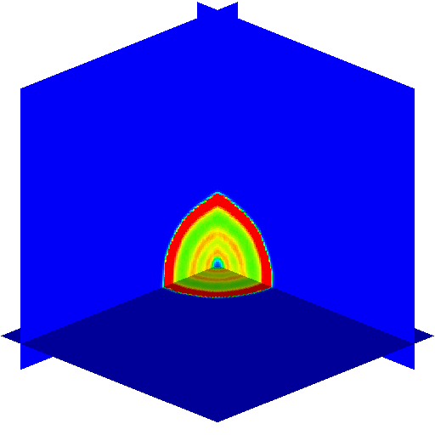
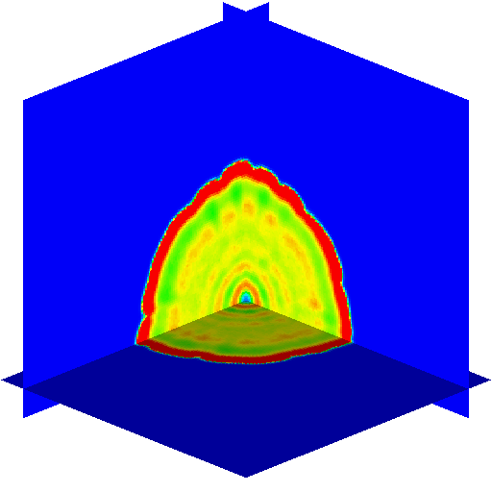
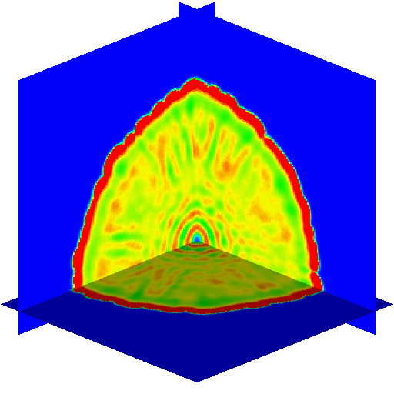
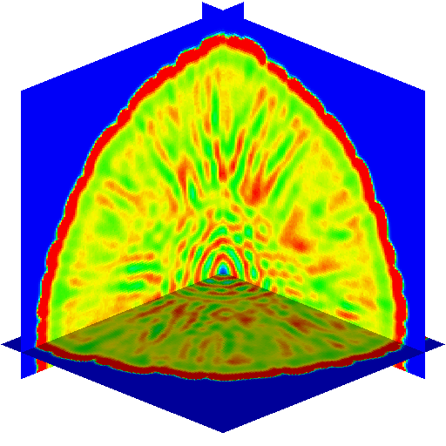
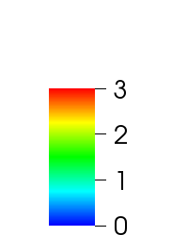
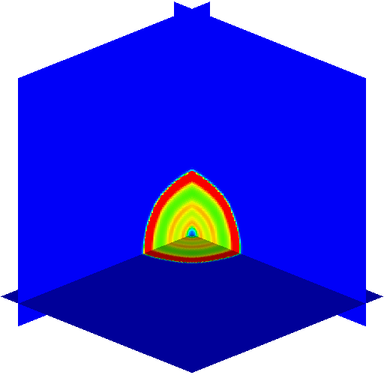
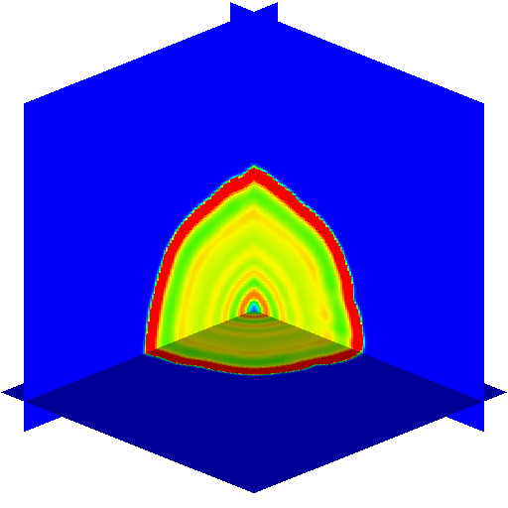
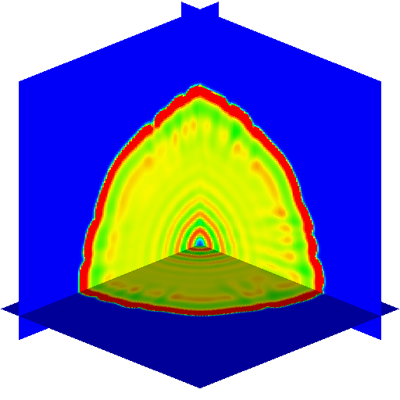
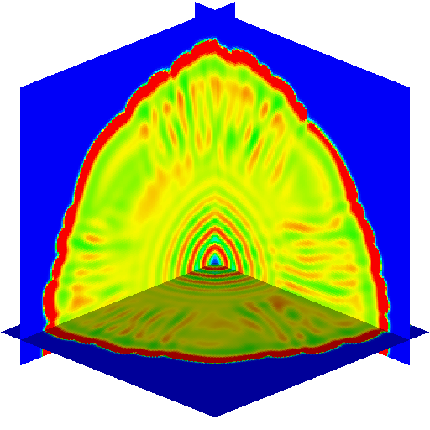
Stochastic Simulation of Reaction-Diffusion Systems:
A Fluctuating Hydrodynamics Approach
J. B. Bell¹, C. Kim¹, A. Nonaka¹, A. L. Garcia², and A. Donev³
¹Lawrence Berkeley National Laboratory
Center for Computational Sciences and Engineering
²San Jose State University, ³Courant Institute
Abstract
Results
Chemo-hydrodynamic instabilities (ongoing work)
We generalize our formulation so that reaction and diffusion are coupled with fluid flow. One interesting example is the formation of asymmetric convective fingers observed in the Rayleigh-Taylor instability when coupled to a neutralization reaction.
We develop numerical methods for stochastic reaction-diffusion systems based on approaches used for fluctuating hydrodynamics (FHD). Our formulation is similar to the reaction-diffusion master equation (RDME) description when the stochastic PDEs are spatially discretized and reactions are modeled as a source term having Poisson fluctuations. However, unlike the RDME, which becomes prohibitively expensive for a increasing number of molecules, our FHD-based description naturally extends from the regime where fluctuations are strong, i.e., each mesoscopic cell has few reactive molecules, to regimes with moderate or weak fluctuations, and ultimately to the deterministic limit. In addition, our approach can be readily generalized to more realistic diffusion models and naturally coupled with (fluctuating) hydrodynamic equations.
1D Schlögl model
We first validate our formulation and numerical schemes using analytic results for steady-state properties of this simple model.
HCl + NaOH → NaCl + H₂O
Corresponding no-reaction case
Thermodynamic equilibrium, strong fluctuations:
For 10 molecules per cell, our method accurately reproduces the Poisson distribution. This is not trivial at all because we use continuous-range number density and Gaussian white noise. This also validates our choice for the face average, .
NaOH (aq) (denser)
Motivation
HCl (aq)
Modeling chemical reactions at different scales
Macroscopic scales
Law of mass action → ODEs
Efficient ODE integration algorithms
Microscopic scales
Chemical master equation
Model as Markov process (SSA)
At intermediate scales, law of mass action is not correct but SSA is too expensive.
New approach based on fluctuating hydrodynamics
Stochastic PDE for diffusion
Tau-leaping treatment of chemistry
Generalized to include effects of fluid flow
Out of equilibrium, weak fluctuations:
Linearized analysis on the structure factor shows that our implicit scheme (ImMidTau) gives very accurate structure factors even if time step size is much larger than the stability limit ∆t_{max}. The resulting structure factor is third-order accurate.
t = 8 s
t = 16 s
ExMidTau
∆t = 0.5 ∆t_{max}
Conclusions and Future Work
ImMidTau
∆t = 5 ∆t_{max}
Based on our analytical and numerical investigation, we conclude that our algorithm (ImMidTau) is an efficient and robust alternative numerical method for stochastic reaction-diffusion simulations.
Computational cost does not increase for increasing number of molecules per cell. Hence, our method can efficiently simulate reaction-diffusion systems over a broad range of relative magnitude of the fluctuations.
The scheme allows a significantly larger time step size without degrading accuracy compared to existing RDME-based numerical methods.
Our FHD-based approach can take advantage of efficient parallel algorithms.
The method has been generalized to more complex problems that include fluid flow with realistic multi-component diffusion.
Future work: ionic species will be included for the simulation of electro-chemical phenomena in electrolyte solutions.
2D Pattern formation
We test our numerical methods on a time-dependent problem and compare them with a reference RDME-based method.
We combine the efficiency of the fluctuating hydrodynamics approach (→diffusion) and the rigor of the master equation approach (→ reaction).
We characterize the pattern formation using the decay pattern of the average concentration of U molecules.
Approach
Spatial Discretization (set of stochastic ODEs)
Cartesian grid finite volume approach for number densities
1. Diffusion-only SPDEs
Validity beyond the Gaussian approximation, including non-negativity, depends on the form of the face average, , used in the stochastic mass flux.
2. Add reactions
Instead of using the chemical Langevin equation, which can give physically wrong results, we use the tau-leaping method.
This statistical analysis shows that our FHD-based method reproduces the RDME results. However, our method is much faster. If there are many molecules per cell (→ large cross-section value A), the RDME-based algorithm is too slow.
Areas in which we can help
Mesoscopic modeling of reactions
Stochastic simulation algorithms
Hybrid algorithms
1D
3D front propagation
We demonstrate the scalability to large systems and computational efficiency of our FHD approach using this 3-dimensional example. The system is divided into 256³ cells and involves the equivalent of 10¹² molecules.
Areas in which we need help
Stochastic reaction-diffusion
Improved linear solvers for evolving architectures
Programming models to support GPU
Temporal integrator (implicit midpoint + tau-leaping scheme)
Deterministic diffusion part is treated implicitly → stability limit is bypassed.
Second-order weak accuracy for linearized equations
We implement the algorithm using the AMReX software framework.
(available at https://github.com/BoxLib-Codes/FHD_ReactDiff.git)
References
C. Kim, A. Nonaka, J. B. Bell, A. L. Garcia, and A. Donev, “Stochastic simulation of reaction-diffusion systems: A fluctuating-hydrodynamics approach”, J. Chem. Phys. 146, 124110 (2017).
A. K. Bhattacharjee, K. Balakrishnan, A. L. Garcia, J. B. Bell, and A. Donev, “Fluctuating hydrodynamics of multi-species reactive mixtures”, J. Chem. Phys. 142, 224107 (2015).
A. Donev, A. Nonaka, A. K. Bhattacharjee, A. L. Garcia, and J. B. Bell, “Low Mach number fluctuating hydrodynamics of multispecies liquid mixtures”, Phys. Fluids 27, 037103 (2015).
Corresponding deterministic simulation with the same noisy initial condition

